Slide 1


UNCLASSIFIED
Detection and Obfuscation of Deepfake Texts
Adaku Uchendu
UNCLASSIFIED

Slide 2
Outline
Introduction
Motivation
Problem Definition
Authorship Attribution (AA)
Authorship Obfuscation (AO)
Landscape of AA & AO
Open Problems
Conclusion & Future Work

Slide 3
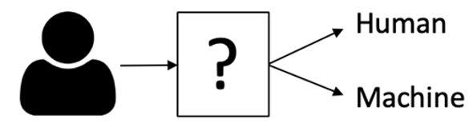
Introduction – Turing Test
Turing Test: is an intelligence test, where a human decides if they are speaking to a human or machine.
Uchendu, A., Cao, J., Wang, Q., Luo, B., & Lee, D. (2019). Characterizing Man-made vs. Machine-made Chatbot Dialogs. In TTO.

Slide 4
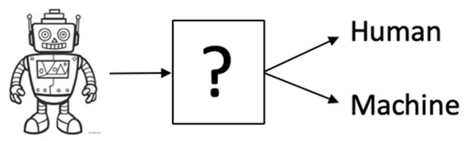
Introduction – Reverse Turing Test
Turing Test: is an intelligence test, where a human decides if they are speaking to a human or machine.
Reverse Turing Test: is an intelligence test, where a Computer Algorithm decides if they are speaking to a human or machine. This is Automatic Turing Test.
Uchendu, A., Cao, J., Wang, Q., Luo, B., & Lee, D. (2019). Characterizing Man-made vs. Machine-made Chatbot Dialogs. In TTO.

Slide 5
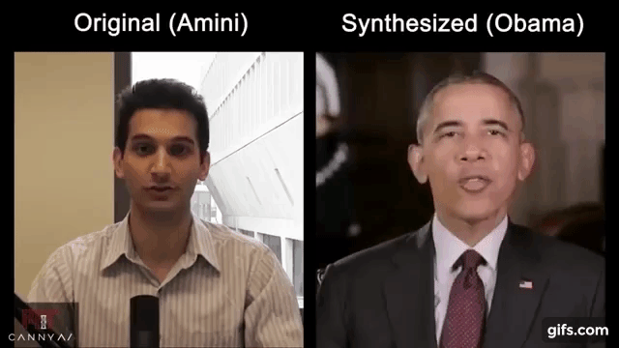
Motivation – Deepfake

Slide 6
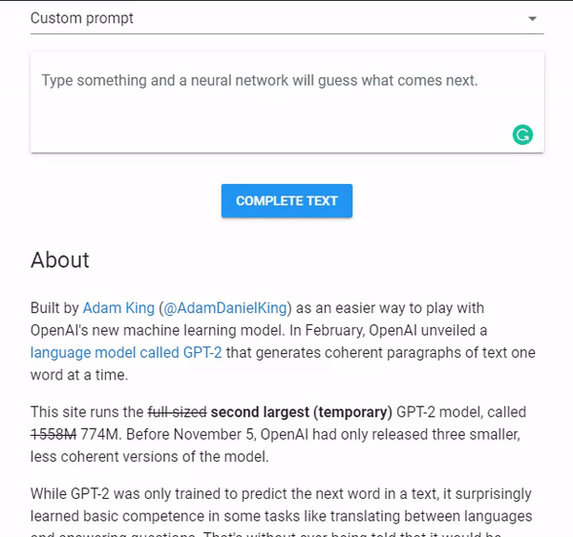
What are Neural Text Generators (NTGs)?
Neural text-generator
Machine text-generator
AI text-generator
Artificial text-generator
Synthetic text-generator
Computer text-generator
Deepfake text-generator

Slide 7
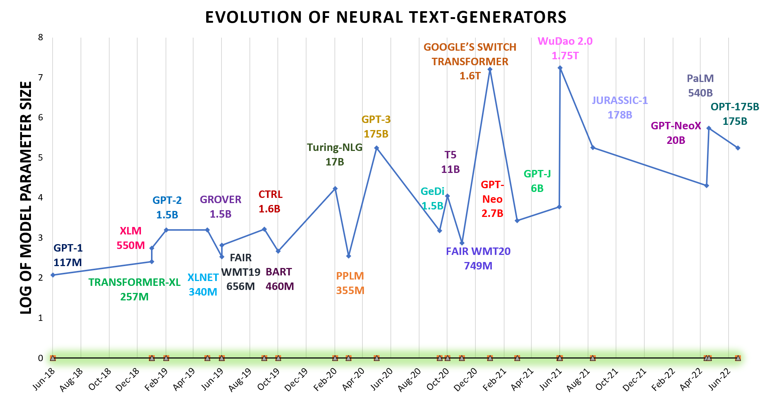
Motivation – Evolution of Neural Text Generators
NTGs are becoming ubiquitous at an alarming rate
Newer NTGs are more sophisticated
Maliciously used to generate misinformation
Huggingface's data repo currently houses more than 3500 English Text generators
Uchendu, A., Ma, Z., Le, T., Zhang, R., & Lee, D. (2021, November). TURINGBENCH: A Benchmark Environment for Turing Test in the Age of Neural Text Generation. In Findings of the Association for Computational Linguistics: EMNLP 2021 (pp. 2001-2016).

Slide 8
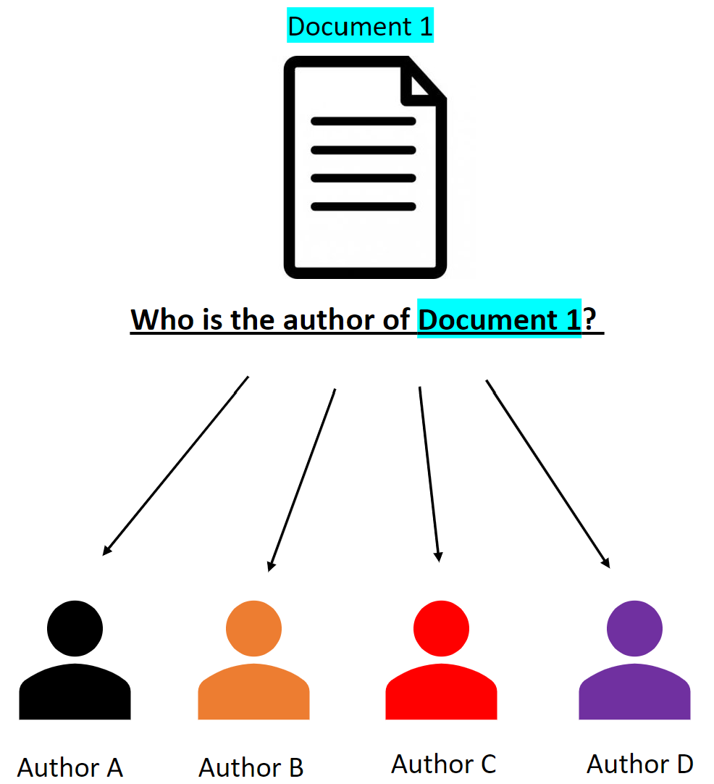
Authorship Attribution (AA)​
AA is the task of accurately assigning a given document to its true author ​
Uchendu, A., Le, T., Shu, K., & Lee, D. (2020, January). Authorship attribution for neural text generation. In Conf. on Empirical Methods in Natural Language Processing (EMNLP).

Slide 9
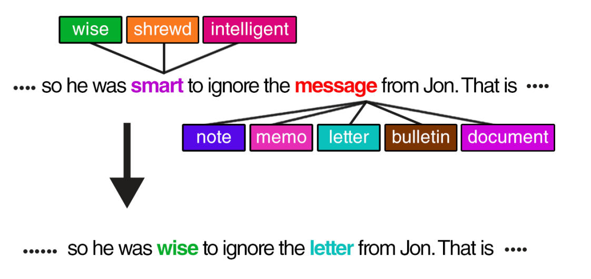
Authorship Obfuscation (AO)
AO is the task of masking an author's writing style/signature to conceal identity, usually for privacy reasons (ex: activists)​
Mahmood, A., Ahmad, F., Shafiq, Z., Srinivasan, P., & Zaffar, F. (2019). A Girl Has No Name: Automated Authorship Obfuscation using Mutant-X. Proc. Priv. Enhancing Technol., 2019(4), 54-71.

Slide 10
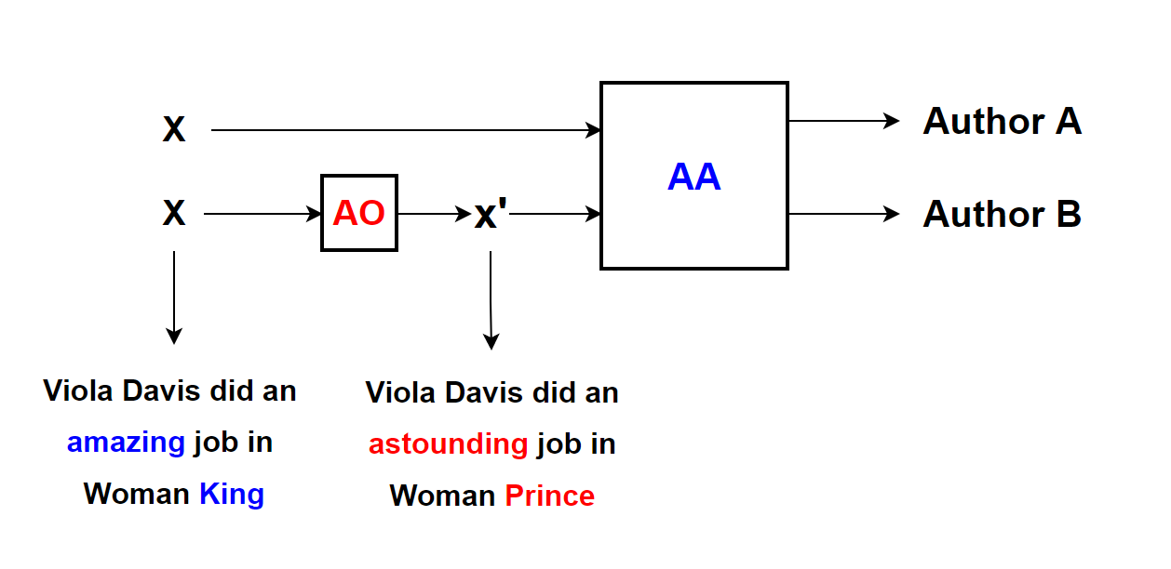
Why does AA & AO matter for neural text detection?
Uchendu, A., Le, T., & Lee, D. (2022). Attribution and Obfuscation of Neural Text Authorship: A Data Mining Perspective. arXiv preprint arXiv:2210.10488.

Slide 11
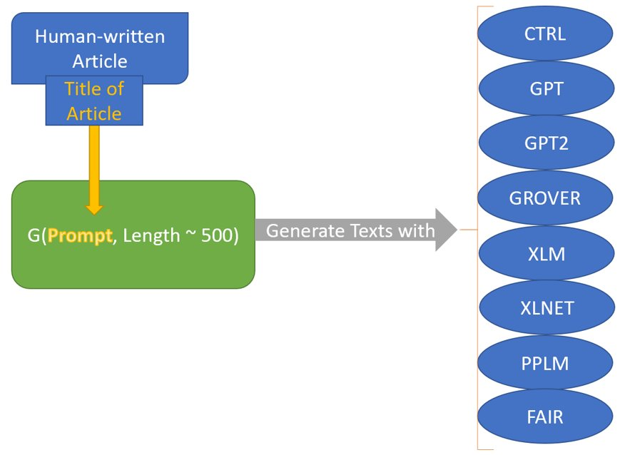
Data Generation Process
Collect human-written documents​
Use Title of human-written document as prompt​
With Prompt, generate texts with NTGs​
NTG texts is similar to human-written​
Uchendu, A., Le, T., Shu, K., & Lee, D. (2020, January). Authorship attribution for neural text generation. In Conf. on Empirical Methods in Natural Language Processing (EMNLP).

Slide 12
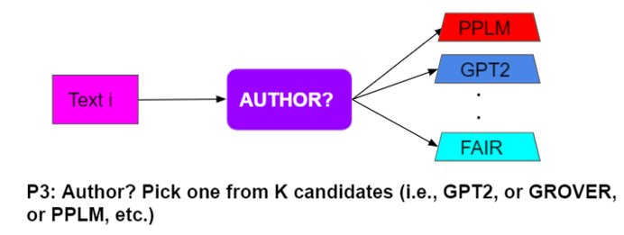
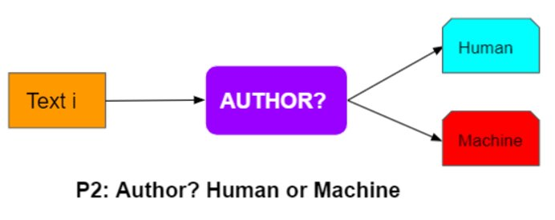
Authorship Attribution for Neural Text
Given a text T1, which NTG (among k options) generated T1 (k ≥ 2)?
Most researchers study the AA problem, where k=2 authors – human & machine/neural method
Uchendu, A., Le, T., Shu, K., & Lee, D. (2020, January). Authorship attribution for neural text generation. In Conf. on Empirical Methods in Natural Language Processing (EMNLP).

Slide 13
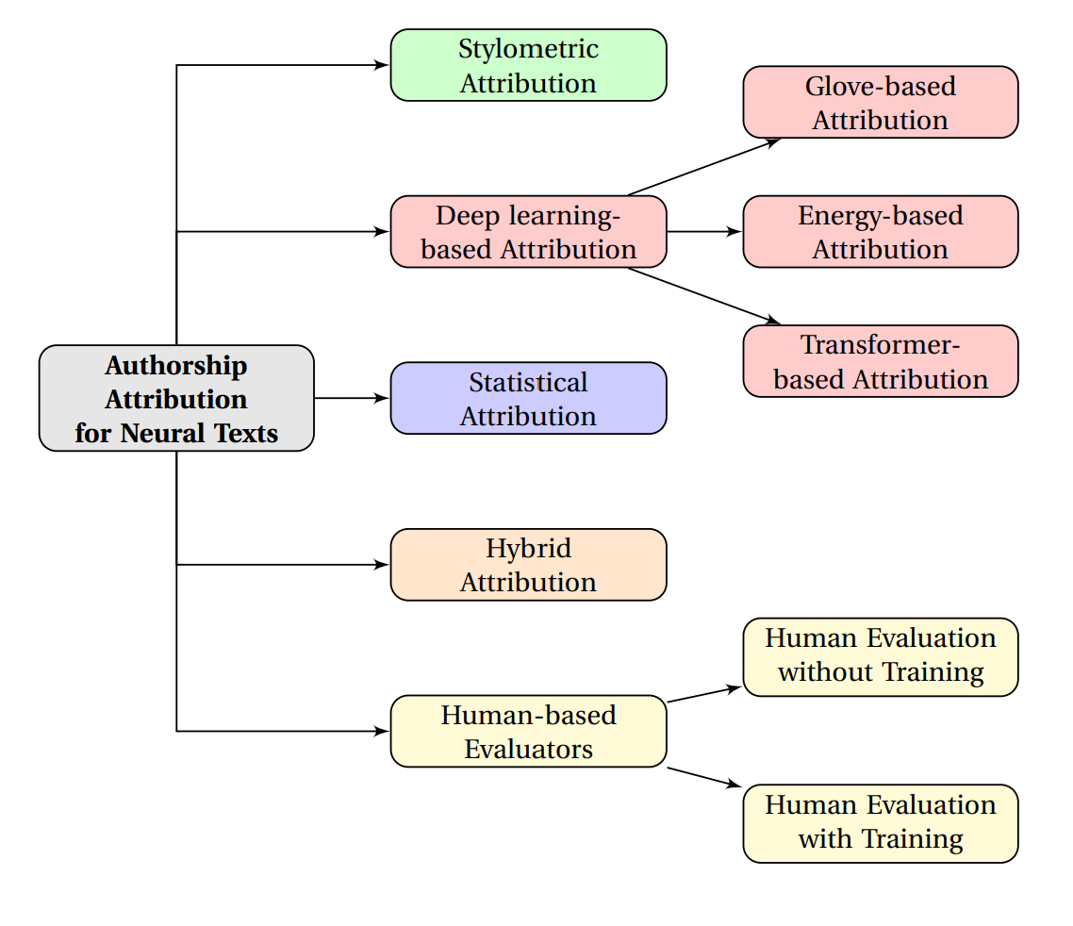
Categories of AA solutions for neural text detection
Uchendu, A., Le, T., & Lee, D. (2022). Attribution and Obfuscation of Neural Text Authorship: A Data Mining Perspective. arXiv preprint arXiv:2210.10488.

Slide 14
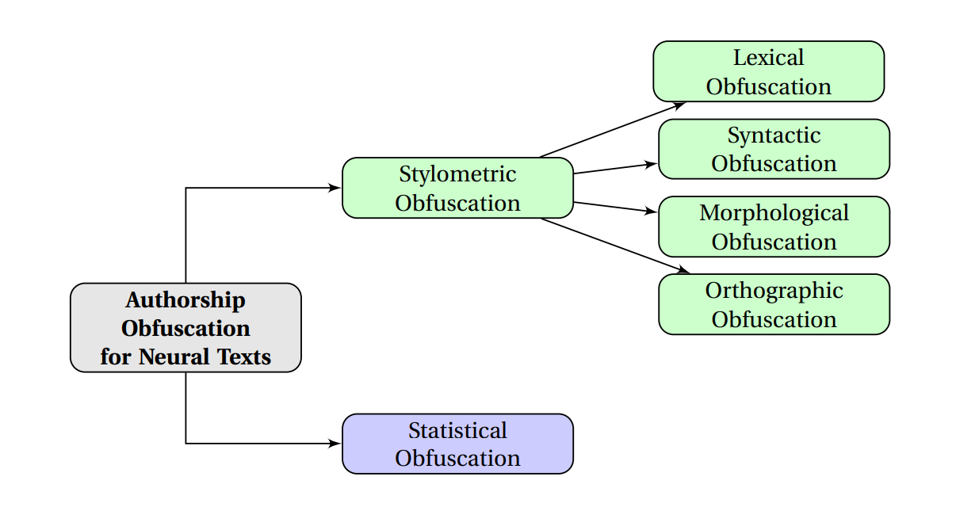
Categories of AO techniques used to obfuscate neural text authorship
Uchendu, A., Le, T., & Lee, D. (2022). Attribution and Obfuscation of Neural Text Authorship: A Data Mining Perspective. arXiv preprint arXiv:2210.10488.

Slide 15
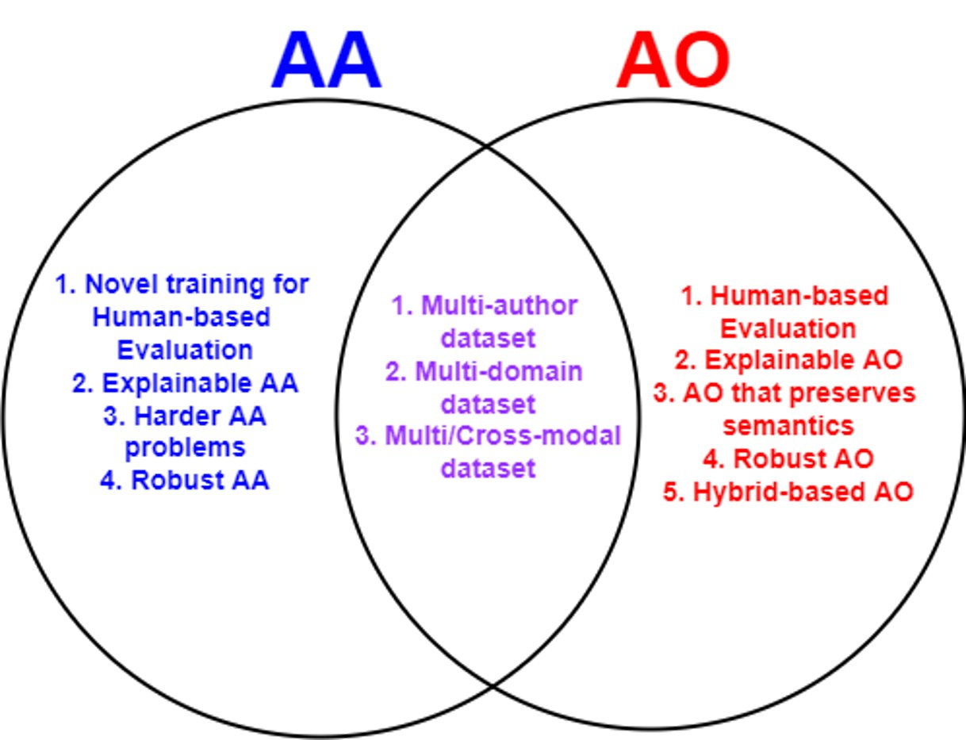
Open Problems
Uchendu, A., Le, T., & Lee, D. (2022). Attribution and Obfuscation of Neural Text Authorship: A Data Mining Perspective. arXiv preprint arXiv:2210.10488.

Slide 16
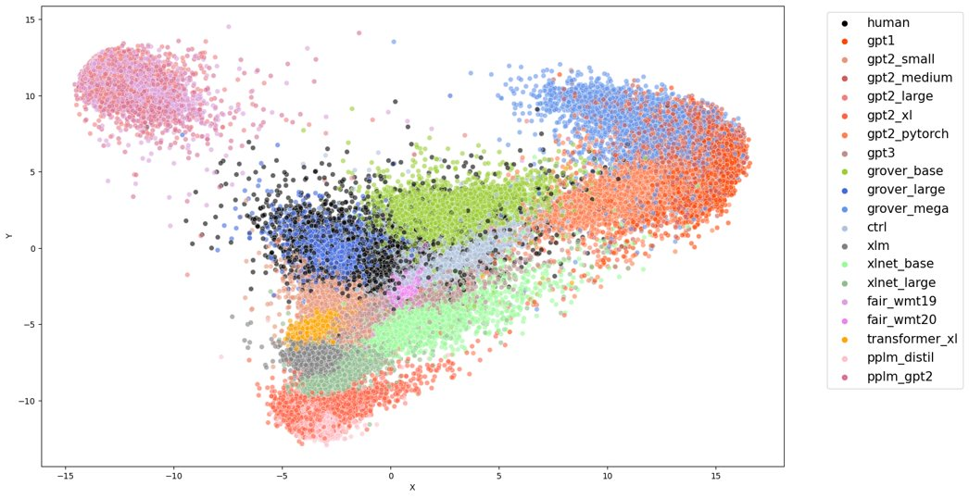
Conclusion
Deepfake/Neural Text Detection (NTD) is non-trivial
AA solutions for NTD are susceptible to AO techniques
DL-based (Transformers) are more accurate than Stylometric & Statistical
Stylometric & Statistical are more adversarially robust to AO techniques than DL-based (Transformers)
Hybrid AA models are the best (robustness, accuracy & generalizability)
Human performance in detection of neural texts is at chance-level
Need better training techniques to improve human performance
PCA Visualization of BERT learned weights​
F1 score – 80%
Uchendu, A., Ma, Z., Le, T., Zhang, R., & Lee, D. (2021, November). TURINGBENCH: A Benchmark Environment for Turing Test in the Age of Neural Text Generation. In Findings of the Association for Computational Linguistics: EMNLP 2021 (pp. 2001-2016).
Uchendu, A., Le, T., & Lee, D. (2022). Attribution and Obfuscation of Neural Text Authorship: A Data Mining Perspective. arXiv preprint arXiv:2210.10488.

Slide 17














Future Work

Slide 18
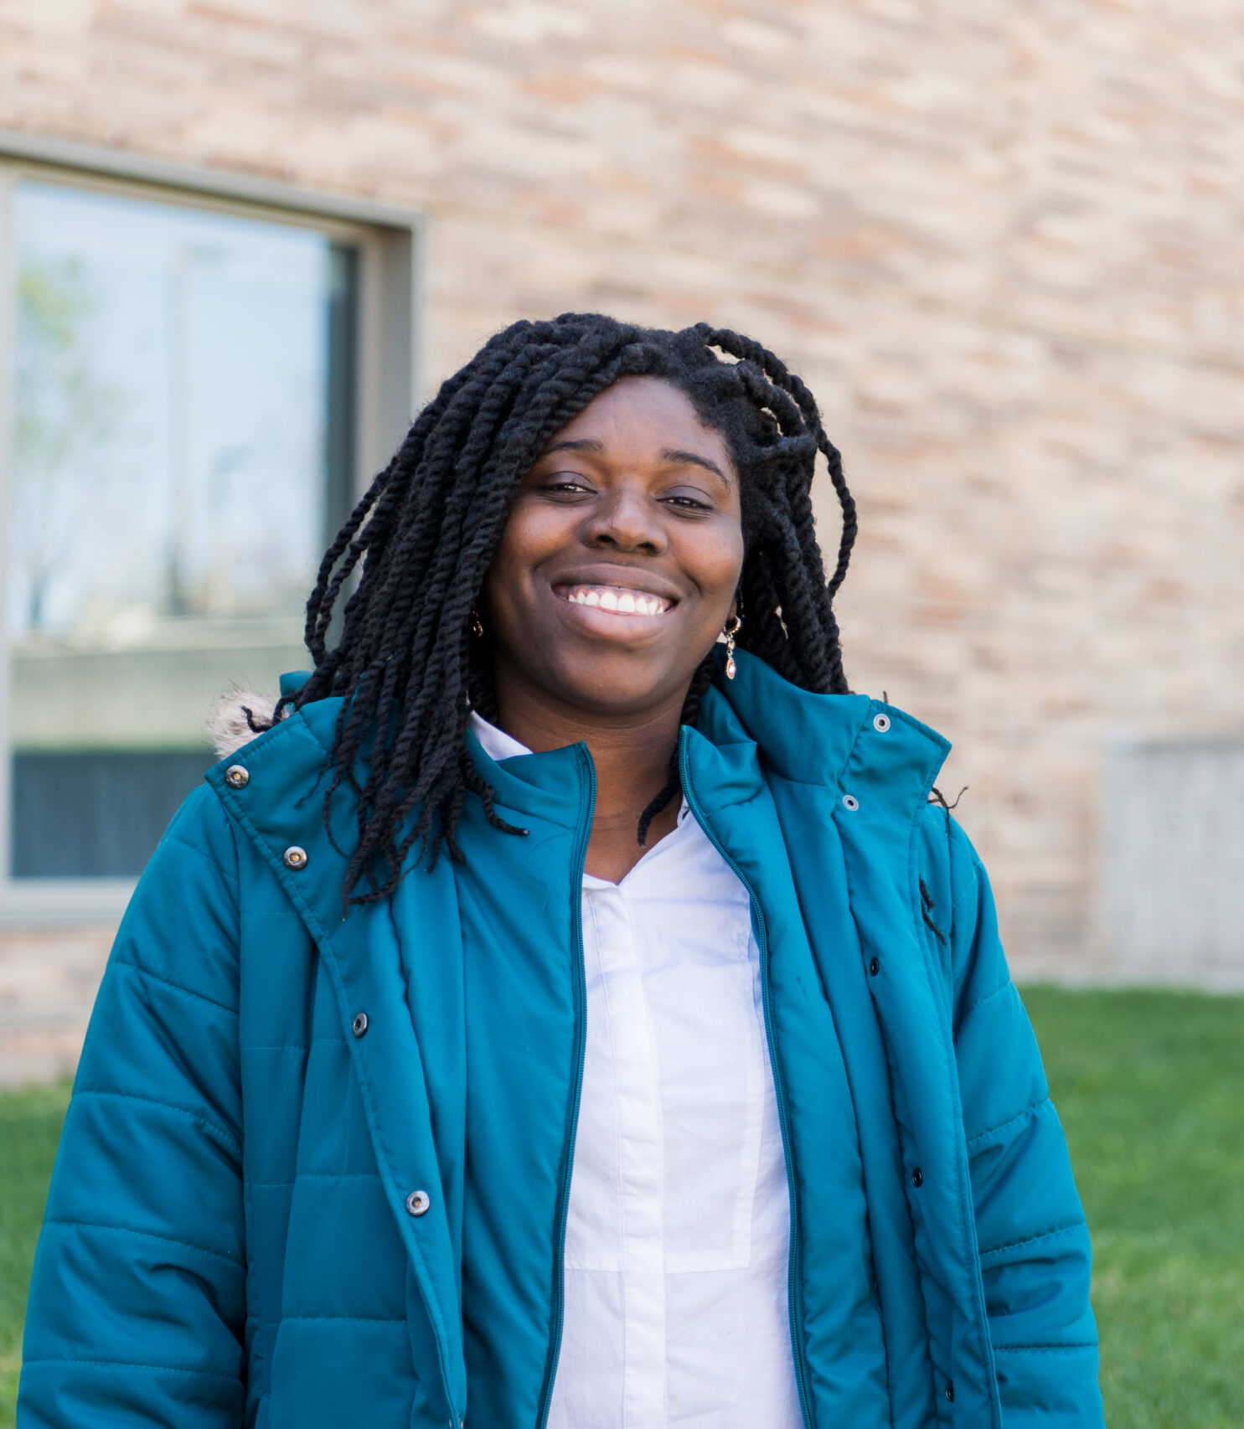
About Me
Name: Adaku Uchendu (she/her)
NSF Scholarship for Service Scholar
Alfred P. Sloan Scholar
Email: azu5030@psu.edu
Affiliation: PIKE Lab, Advisor: Dr. Dongwon Lee
School:
5th-Year Ph.D. student at The Pennsylvania State University
B.S. Mathematics, UMBC (University of Maryland Baltimore County)
Research Focus: NLP, specifically NLG and Machine learning
Personal Website: https://adauchendu.github.io/

